Slide 1
Beyond Sunlight: An Aquatic Chemosynthetic World
Team Singly
Glenn Singer
Matthew Singer
Shane Kelly
Matthew Kelly
Notes:
High level summary: Using sulfur-producing algae to create an aquatic chemosynthetic world on Planet B26.

Slide 2
The Challenge
“Design an ocean world where chemosynthesis, not photosynthesis, sustains life.”
Key considerations:
What chemosynthetic organisms exist on earth, and where do they get their energy and nutrients?
What geological/astronomical features/conditions are required to provide such energy & nutrients?
Deliverables:
Create an imaginary planet that provides a suitable environment for chemosynthetic life
Leverage NASA data to help identify candidate celestial bodies that might support chemosynthetic life
Build a web app allowing users to view candidate bodies and simulate “seeding” with microorganisms

Slide 3
Chemosynthesis on Earth
Microorganisms in dark regions of ocean produce biomass from single-carbon molecules via energy produced by chemosynthesis of…
Hydrogen sulfide (Thiobacillus)
Nitrogen (Nitrobacter and Nitrosomonas)
Iron (Leptothrix and Gallionella)
Methane (Methylococcus, Methylobacter, Methanococcus, Methanosarcina)

Slide 4
Geological Features
Numerous features on earth support chemosynthetic life:
Hydrothermal vents
Methane clathrates
Cold seeps
“Whale falls”
Isolated cave water
In general, bodies that we’d consider candidates for supporting chemosynthetic life would have to possess:
Oceans
Molten core (thus providing hydrothermal vents, cold seeps, and methane clathrates)
Nitrogen, sulfur, iron

Slide 5
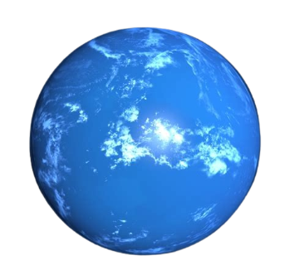
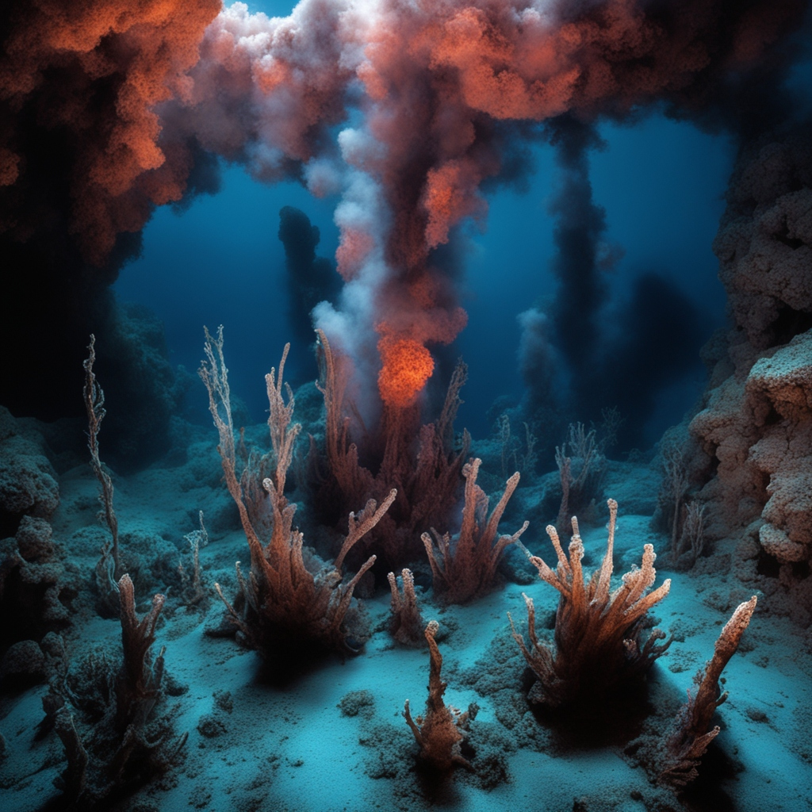
B26: Our Imaginary Planet of Chemosynthetic Life
4 seasons like Earth’s
Average temperature 20° C, with fluctuations of up to ±27° C
Ice asteroid collision gave it water, islands and metallic nodules
Metallic nodules produce “dark” oxygen
Peculiar orbit
412 days in a year
17 earth hours in a day
Mineral-rich water
Life did not develop on its own; was “seeded” by mission from Earth

Slide 6
Identifying Candidate Planets
We used NASA’s Ocean Worlds Resources to identify planets and moons in our solar system that might be supportive of chemosynthetic organisms
We identified the following bodies:
Europa
Ganymede
Enceladus (maybe; no direct evidence but possible)
The bodies all meet the geologic criteria: oceans, molten cores, and other necessary elements (nitrogen, sulfur, iron)

Slide 7
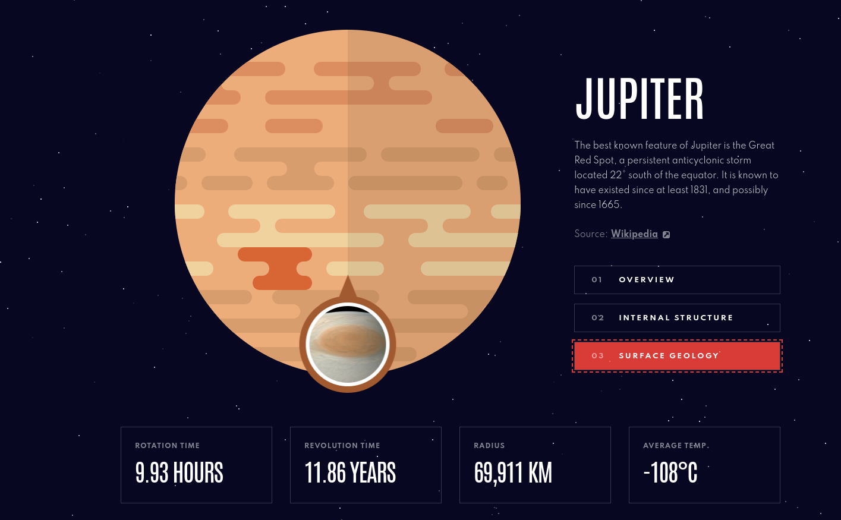
Web App: Fertile Exo-Oceans Explorer
Phase 1: Candidate Celestial Bodies Possibly Supportive of Chemosynthetic Life Browser
Browse all candidate celestial bodies
View their salient geologic properties (thermal vents, oceans, etc.) using latest data from NASA
View the “menu” of chemosynthetic organisms that would most likely thrive there
Phase 2: Seeding Simulation (“Primordial Soup Injector”)
Users can simulate “seeding” the body with chemosynthetic microorganisms to see how they might survive
Would need to model dynamic ecosystem as microorganism’s metabolic byproducts alter the chemistry of the oceans.

